Slide 1
SD 806
Publishing at Smithsonian
And by employees
Lauryn Guttenplan and Meghan Berroya, Office of General Counsel
Ginger Minkiewicz, Smithsonian Scholarly Press
Carolyn Gleason, Smithsonian Books
Susan Engelhardt, Office of Contracting & Personal Property Management

Slide 2
Let’s Bust a Myth!

Slide 3
Intellectual Property: Ownership of Works
What Is a “Work”?
Document or Manuscript
Print, digital or other format
Formal (e.g., book) or informal (e.g., blog post)
Prepared by employee as part of official duties
Prepared by third party for the Smithsonian under contract (work-made-for-hire)
Licensed to the Smithsonian for publication

Slide 4
Who Owns the Work?
General rules under Copyright Act
Works by employees as part of official duties (work-made-for-hire) (trust fund employees)
Works by federal employees as part of official duties
What is the public domain?
Third-party contractors
work-made-for-hire;
transfer of ownership;
license

Slide 5
Multiple Owners
Multiple authors
Discrete and segregable ownership
Shared or joint copyright
Mix of trust and federal employee work product
Multiple sources of content (compilation)

Slide 6
How to Provide Notice of Copyright
Standard copyright notice (© + year of publication + owner);
Proper Smithsonian notices
© 2020 Smithsonian Institution
Copyright 2020 Smithsonian Institution
Copyright © 2020 by Smithsonian Institution
Compilation © 2020 Smithsonian Institution
No Unit Notices
Option: No notice (Berne Convention)
Public Domain
Creative Commons license (CC0)

Slide 7
Smithsonian Scholarly Press
Open Scholarly Access Books
☑ ☑ Eligible = research results by SI employees and by Fellows (within 5 years)
☑ ☑ All disciplines of Smithsonian research and collections
☑ ☑ Peer reviewed
☑ ☑ Standard production services (copyediting through printing) at no cost to units
☑ ☑ No royalties or profit-share to units
☑ ☑ Average production time 7-8 months (after peer review)
☑ ◻ Digital first, print follows 6-8 weeks later. Limited print copies available upon request at no charge.
☑ ◻ Copies mailed worldwide to fulfill SIL Exchange program.
◻ ☑ Print format. E-book if all permissions allow.
◻ ☑ Sales and distribution through Penguin Random House.
◻ ☑ Less technical scholarly content with general appeal.

Slide 8
Smithsonian Enterprises Publications for a General Audience (Not Scholarly)
Smithsonian Books
Adult trade nonfiction, illustrated, family reference, exhibition and collections, art books, guidebooks
Sales and distribution through Penguin Random House
MOU between SE and Unit
Royalties to Unit
Book packaging and distribution
Consumer & Education Products
Children’s, teacher’s, family reference, special format, adult
Licenses
Works with variety of leading publishers
Negotiates with OCon on Unit’s behalf
Licensing fees to Unit

Slide 9
Special Circumstances – Tricky Scenarios
Works created partially prior to joining the Smithsonian and partially as a Smithsonian employee.
Works that are started while a Smithsonian employee and completed after leaving.
The policy directly addresses both scenarios.
Specific facts matter.
Particular circumstances will be addressed by Unit directors in conjunction with OGC.

Slide 10
Substantial Work Finished Before Employment
Employee completes substantial portion of a work (e.g., a dissertation) before coming to SI and will finish as part of official duties, Unit Director may approve 50/50 royalty split between the Unit and author in her personal capacity.
In this scenario, SI negotiates publication agreement, with author consultation.
Author owns copyright in the underlying dissertation completed prior to joining, and SI owns the copyright in the finished publication.
Exceptions require OGC approval.

Slide 11
Post-Employment Publication of Works
Former employee publishing a work substantially prepared as part of job prior to leaving, employee shall first allow SI the chance to publish.
If SI declines, with permission of employee’s former Unit Director, departing author may pursue publication independently.
Royalties may be split between Unit and employee personally with a presumption of a 50-50 split.
If departing employee maintains status as emeritus or volunteer and will complete the work while in that status, employee must consult with OGC before accepting royalties and is subject to publication guidelines in the Smithsonian Directives governing emeritus and volunteer status.
Questions concerning “substantial” should be directed to OGC to determine in consultation with the Unit.

Slide 12
For all special circumstances…
Best to define how these matters will be handled as early in the process as possible.

Slide 13
Case Study: From Dissertation to Book
Kit is a curator at NMAH who studies the intersection of superheroes and popular culture. He was hired in part based on the strength of his dissertation, How Batman and Comic Book Characters Relate to Our Current Political Climate. His performance plan includes continued research and writing on the topic and transforming it into a published book.

Slide 14
Case Study - continued
What will happen concerning royalties and copyright for the book?
When should Kit clarify expectations surrounding the book?
What if Kit had done some research on the topic, but not a full dissertation before he joined NMAH, how could that change the facts?
What if he had already drafted the book but it was not yet published before he joined?
If Kit decided instead to write a book about his hobby, dog breeds that are best for families, how should he proceed?
What would you expect the outcome to be?

Slide 15
Case Study: Publication After Retirement
Jamie is retiring after he worked at NASM as a curator for 40 years. While at NASM, Jamie researched and wrote about the commercialization of space flight. Jamie intends to continue this research during his retirement, and is hoping to take his previous writings as well as his continued research and turn them into a book.

Slide 16
Case Study - continued
What should Jamie do?
What steps will Jamie need to follow?
What is the likely outcome with respect to royalties?
What changes if Jamie never researched or wrote about the commercialization of space flight as a curator?
Does anything change if Jamie will be in emeritus status?
Does anything change if his continued research will be based on NASM’s collection?
What if he is given special access to the NASM Archives by virtue of his emeritus status?

Slide 17
Contracting Authority for Publishing Agreements
Publishing agreements are legally binding contracts.
Who signs publishing agreements for SI authors?
Smithsonian Contracting Officer, OCon & PPM
Employee with delegated authority
Certain employees may receive permission to sign certain types of publishing agreements
Signatory signs on behalf of SI, not in a personal capacity

Slide 18
Contracting Authority for Publishing Agreements
Authority for Internal Publishing
Terms of publication are memorialized in writing between SI publisher and SI author
Authority for External Publishing
Publisher typically asks SI author to sign a publishing agreement or complete an online click license

Slide 19
Contracting Authority for Publishing Agreements
Appendix
Identifies who can review, negotiate and sign publishing agreements for externally published works
Formal vs Informal Works
Supplemental Terms

Slide 20
https://interdisciplinary.si.edu/collaboration-highlights/public-access/

Slide 21
Sample Workflow for Journal Article
When accepted, journal/publisher sends SI author contract that requires signature.
SI author creates public access ticket, attaches contract for review and signature, and attaches accepted manuscript.
SISP reviews and signs contract then sends to SI author for upload to publisher’s online system. SISP cc’s SI author on correspondence if negotiation is required.
SI author prepares manuscript for journal/publisher.
SI author downloads Supplemental Terms.
SI author submits manuscript (with Suppl. Terms) through publisher’s online system.
SI author completes click license.
SI author might be asked to identify ownership (e.g., U.S. Government employee, if Federal)
Publisher conducts peer review
SI author revises and submits final manuscript
Publisher accepts manuscript.
SI author receives page proofs.

Slide 22
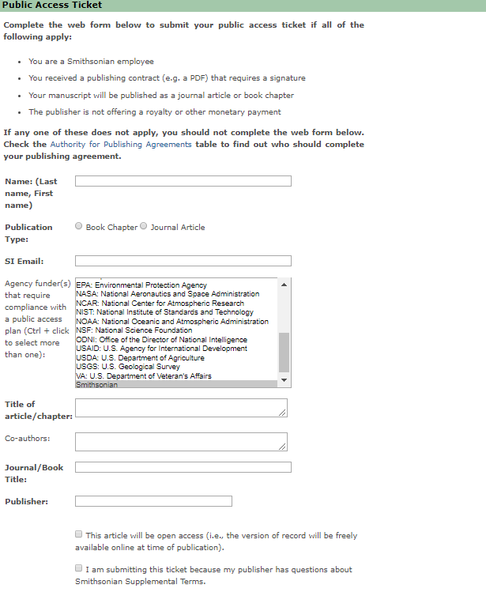
Submitting a Public Access Ticket
https://publicaccess.si.edu on SI network
If all bullets apply, complete form.
Funder(s)
Article details
Open access checkbox when applicable; includes hybrid.
Smithsonian does not require employees to publish OA.
Attach contract.
Attach accepted manuscript.
Instructions at bottom of form for SI staff to deposit data in SI’s Figshare repository for open data.

Slide 23
NEED HELP?
For more information, SD 806’s “References” section includes contact information for all related offices.
Legal questions: LegalHelp@si.edu
Ethics questions: OGCEthics@si.edu
OConHelp: https://si-jira.si.edu/plugins/servlet/desk/portal/1
Public Access ticket: publicaccess@si.edu

